Slide 1
COA PPT presentation
Subject : COA
Section : M
Batch – 18
231fa04885 - Riyaz
231FA04912 - Gowtham
231FA04A08 - Ravi Kiran
231FA04g93 – Sindhu meghana

Slide 2
A) Give a brief Note on the Hardware implementation and algorithm for Addition and Subtraction.
Addition:
Full Adder Circuit: The basic hardware unit for binary addition is the full adder. It takes two input bits (A and B) and a carry-in (Cin), and produces a sum bit (S) and a carry-out (Cout).
Sum S=A⊕B⊕CinS = A \oplus B \oplus CinS=A⊕B⊕Cin
Carry Cout=(A&B) ∣ (Cin&(A⊕B))Cout = (A \& B) \ | \ (Cin \& (A \oplus B))Cout=(A&B) ∣ (Cin&(A⊕B))
Ripple Carry Adder: For adding multi-bit numbers, a series of full adders are connected, where the carry-out of one adder becomes the carry-in of the next.
Carry Look-Ahead Adder (CLA): To improve speed, a CLA reduces the propagation delay by calculating carries in parallel, rather than sequentially.

Slide 3
Subtraction:
Using Adders for Subtraction: Subtraction can be performed using an adder by representing the subtraction as an addition of a negative number. This is achieved using the two's complement representation:
For subtracting A−BA - BA−B, compute A+(Two’s complement of B)A + \text{(Two’s complement of B)}A+(Two’s complement of B).
Two's Complement Converter: A two's complement operation inverts the bits of BBB and adds 1 to it. This transformed value is then added to AAA using an adder.
Borrow Propagation: In binary subtraction, a borrow may be generated at each bit. This is similar to carry in addition, but instead, the borrow must be handled across bits.

Slide 4
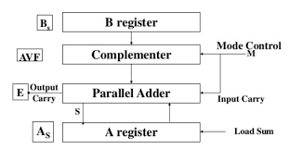
Hardware implementation

Slide 5
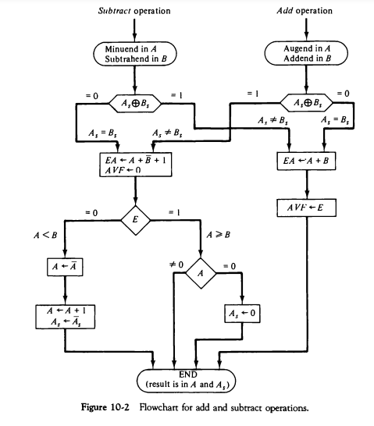
Flow Chart For Add and subtract operations

Slide 6
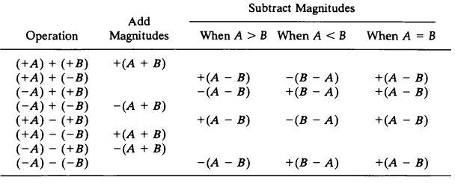
Addition and subtraction for signed magnitude Numbers

Slide 7
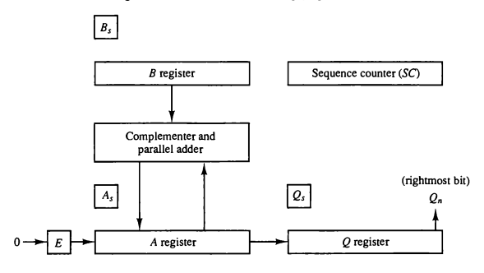
Hardware for multiply Unsigned numbers
B)Design an algorithm to multiply two unsigned hexadecimal numbers in the range of A1<N< F3.

Slide 8
Algorithm:
Let the two hexadecimal numbers be N1N_1N1​ and N2N_2N2​, where A1≤N1,N2≤F3A1 \leq N_1, N_2 \leq F3A1≤N1​,N2​≤F3.
Convert both N1N_1N1​ and N2N_2N2​ from hexadecimal to decimal.
Multiply the two decimal numbers obtained from step 2.
Convert the product obtained from the multiplication back to hexadecimal.
Return the product in hexadecimal form.

Slide 9
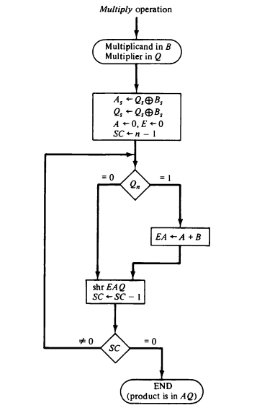
Flowchart :

Slide 10
C)Justify the algorithm that suits best for performing the multiplication of signed numbers. Explore the multiplication of two signed decimal numbers which are in the range of –A2<N<A2
For multiplication of signed numbers, "Booth's Algorithm" is widely considered one of the most efficient algorithms. It is a multiplication algorithm that handles both positive and negative binary numbers effectively, particularly in cases where numbers are in two’s complement representation. The key advantage of Booth's Algorithm is that it can handle both addition and subtraction of numbers without needing separate hardware for negative values.

Slide 11
Input:
Let the two numbers to be multiplied be MM (multiplicand) and QQ (multiplier).
Represent both MM and QQ in binary (using 2's complement representation for signed numbers).
Initialize:
A=0A = 0 (Accumulator) — set to 0.
QQ — the multiplier.
Q−1=0Q_{-1} = 0 — previous bit of multiplier.
Set the number of iterations to the bit length nn of the multiplier (i.e., for an nn-bit number).
Repeat for nn iterations:
Examine the current least significant bit Q0Q_0 of the multiplier and the previous bit Q−1Q_{-1}:
(Q₀, Q₋₁) = (00): No operation (just perform an arithmetic shift).
(Q₀, Q₋₁) = (01): Add MM to AA, then perform an arithmetic shift.
(Q₀, Q₋₁) = (10): Subtract MM from AA, then perform an arithmetic shift.
(Q₀, Q₋₁) = (11): No operation (just perform an arithmetic shift).
Shift left the combined register (A,Q,Q−1)(A, Q, Q_{-1}) by 1 bit (arithmetic shift).
After nn iterations, the result of the multiplication is stored in (A,Q)(A, Q), where:
AA contains the upper bits of the result.
QQ contains the lower bits of the result.

Slide 12
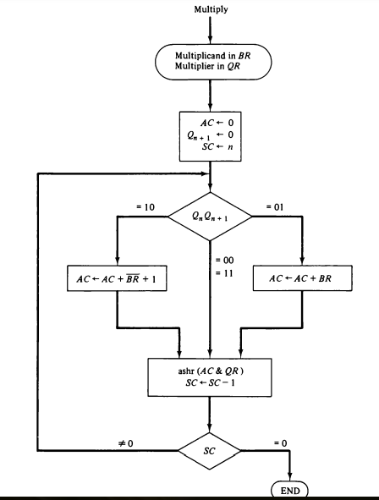
Flow Chart :

Slide 13
Example :
Q= -8(11000)
M=5(00101) -M=11011
Count | A | Q | Q-1 | M
5 4 | 00000 00000 | 11000 01100 | 0 0 | 00101 (ARS)
3 | 00000 | 00110 | 0 | 00101(ARS)
2 | 00000 11011 | 00011 | 0 | 00101(ARS) A<--A+(-M)
1 | 11011 11101 | 00011 10001 | 0 1 | 00101 (ARS)
0 | 11110 | 11000 | 1 | 00101(ARS)

Slide 14
The product is stored in AQ form and in 2's Complement.
So, to convert it into normal binary form and we obtained in 00001 01000.
The obtained binary in decimal form is –40.
Hence we get the Thus, -8 × 5 = -40, verified by Booth's algorithm.

Slide 15
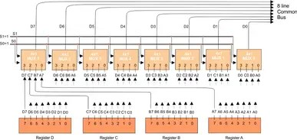
Extension :
4 -8 bit Register to bus transfer diagram

Slide 16
Four 8-bit Registers (R1, R2, R3, R4):
Each register stores 8 bits of data and has two primary operations: reading data from the bus and writing data to the bus.
The registers are connected to the bus, allowing data to be transferred between them.
8-bit Bus:
The bus is a collection of 8 data lines (representing the 8-bit data). It allows data transfer between registers or other components like the ALU (Arithmetic Logic Unit) or memory.
Multiplexers (MUX):
A multiplexer is used to select which register’s data will be connected to the bus for reading or writing.
Each register can be connected to the bus using a multiplexer, which selects one of the registers to communicate with the bus based on control signals.
Selection Lines:
The multiplexer uses selection lines (control signals) to determine which register is selected to send or receive data through the bus.
Since we have four registers, we need two selection lines (denoted S1 and S0) to control the 4-to-1 multiplexer.

Slide 17
Control Signals:
Write Enable (WE): This control signal allows data to be written to a register. It is used to enable the selected register to accept data from the bus.
Read Enable (RE): This control signal allows data to be read from the selected register and placed onto the bus.
The selection lines (S1, S0) direct which register’s output is sent to the bus, and the Write Enable signal controls which register can receive data from the bus.
s1 | s0 | Register selected
0 | 0 | A
0 |  | B
1 | 0 | C
1 | 1 | D

Slide 18
Conclusion :
Transfer of data from a 4-8 bit register to a bus plays a crucial role in efficient data communication within digital systems. By implementing appropriate control signals and multiplexing techniques, seamless data transfer can be achieved between registers and buses of varying widths. Proper synchronization ensures compatibility and reliable communication across components, contributing to the overall performance and efficiency of digital circuit designs. This design methodology is fundamental for modern embedded systems and microprocessor architectures, enhancing their capability to handle complex operations.

Slide 19
Thank You

